Slide 1
Digital Computer Arithmetic ECE 666 Part 6a High-Speed Multiplication - I
Israel Koren
Spring 2004

Slide 2
Speeding Up Multiplication
Multiplication involves 2 basic operations - generation of partial products + their accumulation
2 ways to speed up - reducing number of partial products and/or accelerating accumulation
3 types of high-speed multipliers:
Sequential multiplier - generates partial products sequentially and adds each newly generated product to previously accumulated partial product
Parallel multiplier - generates partial products in parallel, accumulates using a fast multi-operand adder
Array multiplier - array of identical cells generating new partial products; accumulating them simultaneously
No separate circuits for generation and accumulation
Reduced execution time but increased hardware complexity

Slide 3
Reducing Number of Partial Products
Examining 2 or more bits of multiplier at a time
Requires generating A (multiplicand), 2A, 3A
Reduces number of partial products to n/2 - each step more complex
Several algorithm which do not increase complexity proposed - one is Booth's algorithm
Fewer partial products generated for groups of consecutive 0’s and 1’s

Slide 4
Booth’s Algorithm
Group of consecutive 0’s in multiplier - no new partial product - only shift partial product right one bit position for every 0
Group of m consecutive 1's in multiplier - less than m partial products generated
...01…110... = ...10...000... - ...00...010...
Using SD (signed-digit) notation =...100...010...
Example:
...011110... = ...100000... - ...000010... = ...100010... (decimal notation: 15=16-1)
Instead of generating all m partial products - only 2 partial products generated
First partial product added - second subtracted - number of single-bit shift-right operations still m
-
-

Slide 5
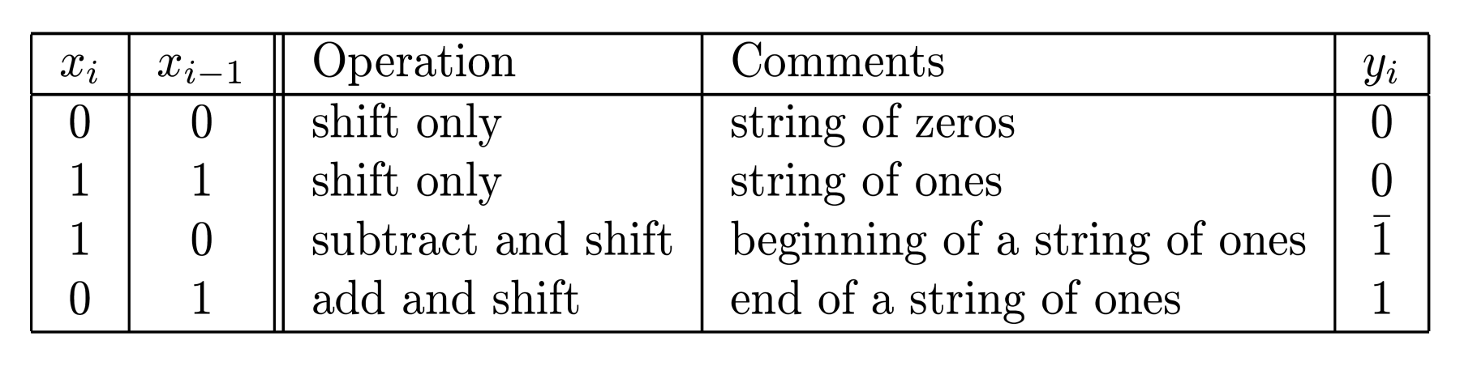
Booth’s Algorithm - Rules
Recoding multiplier xn-1 xn- 2...x1 x0 in SD code
Recoded multiplier yn-1 yn-2 ... y1 y0
xi,xi-1 of multiplier examined to generate yi
Previous bit - xi-1 - only reference bit
i=0 - reference bit x-1=0
Simple recoding - yi = xi-1 - xi
No special order - bits can be recoded in parallel
Example: Multiplier 0011110011(0) recoded as 0100010101 - 4 instead of 6 add/subtracts
-
-

Slide 6
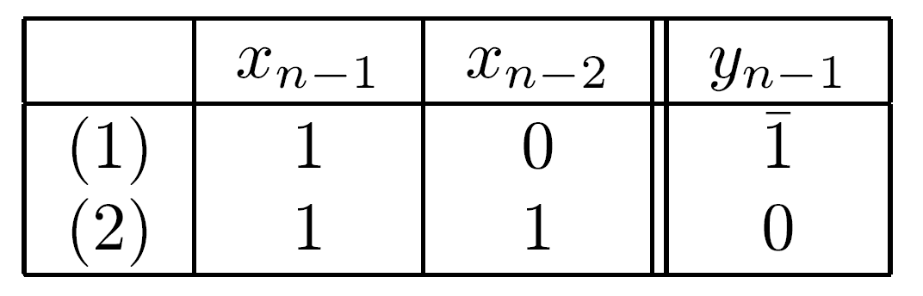
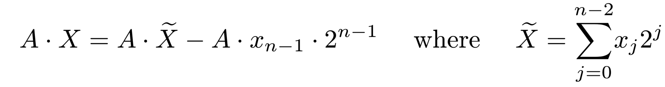
Sign Bit
Two's complement - sign bit xn-1 must be used
Deciding on add or subtract operation - no shift required - only prepares for next step
Verify only for negative values of X (xn-1=1)
2 cases
Case 1 - A subtracted - necessary correction
Case 2 - without sign bit - scan over a string of 1's and perform an addition for position n-1
When xn-1=1 considered - required addition not done
Equivalent to subtracting A⋅2 - correction term
n-1

Slide 7
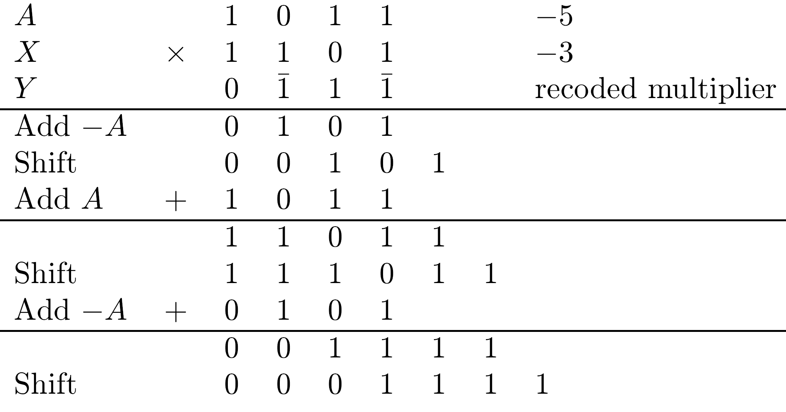
Example (Case-2)

Slide 8
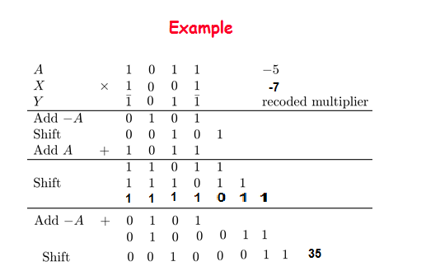

Slide 9
Booth’s Algorithm - Properties
Multiplication starts from least significant bit
If started from most significant bit - longer adder/subtractor to allow for carry propagation
No need to generate recoded SD multiplier (requiring 2 bits per digit)
Booth's algorithm can handle two's complement multipliers
If unsigned numbers multiplied - 0 added to left of multiplier (xn=0) to ensure correctness

Slide 10
Drawbacks to Booth's Algorithm
Variable number of add/subtract operations and of shift operations between two consecutive add/subtract operations
Inconvenient when designing a synchronous multiplier
Algorithm inefficient with isolated 1's
Example:
001010101(0) recoded as 011111111, requiring 8 instead of 4 operations
Situation can be improved by examining 3 bits of X at a time rather than 2
-
-
-
-

Slide 11
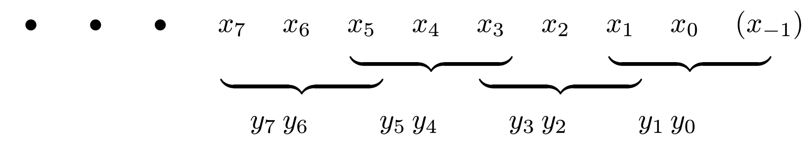
Radix-4 Modified Booth Algorithm
Bits xi and xi-1 recoded into yi and yi-1 - xi-2 serves as reference bit
Separately - xi-2 and xi-3 recoded into yi-2 and yi-3 - xi-4 serves as reference bit
Groups of 3 bits each overlap - rightmost being x1 x0 (x-1), next x3 x2 (x1), and so on

Slide 12
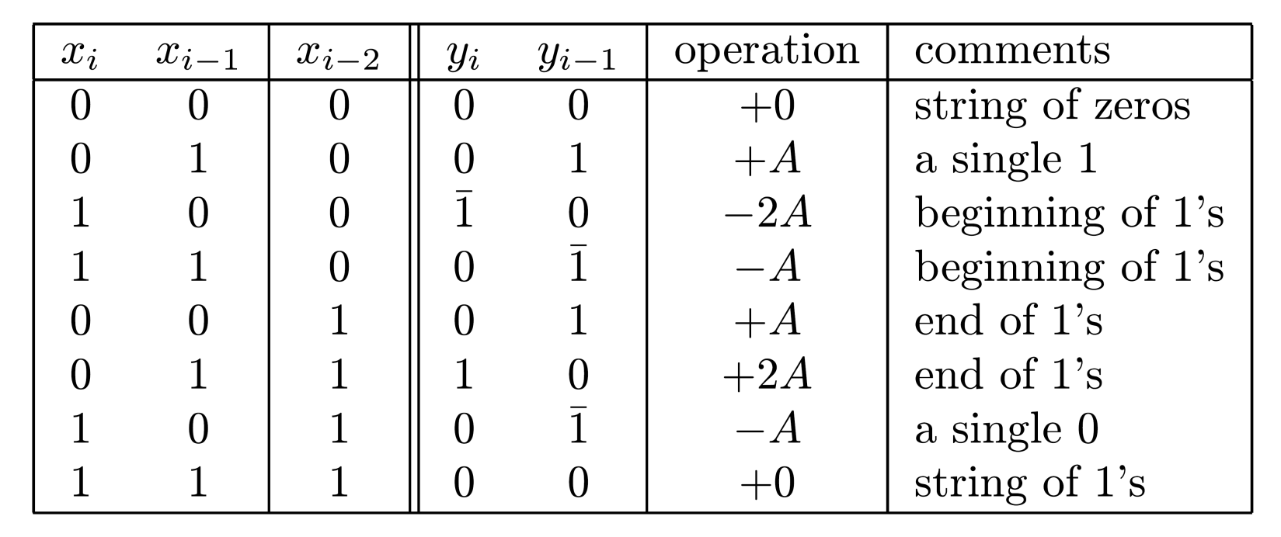
Radix-4 Algorithm - Rules
i=1,3,5,…
Isolated 0/1handled
efficiently
If xi-1 is an isolated 1, yi-1=1 - only a single operation needed
Similarly - xi-1 an isolated 0 in a string of 1's -...10(1)… recoded as ...11... or ...01… - single operation performed
Exercise: To find required operation - calculate xi-1+xi-2-2xi for odd i’s and represent result as a 2-bit binary number yiyi-1 in SD
-
-

Slide 13
Radix-4 vs. Radix-2 Algorithm
01|01|01|01|(0) yields 01|01|01|01| - number of operations remains 4 - the minimum
00|10|10|10|(0) yields 01|01|01|10|, requiring 4, instead of 3, operations
Compared to radix-2 Booth's algorithm - less patterns with more partial products; Smaller increase in number of operations
Can design n-bit synchronous multiplier that generates exactly n/2 partial products
Even n - two's complement multipliers handled correctly; Odd n - extension of sign bit needed
Adding a 0 to left of multiplier needed if unsigned numbers are multiplied and n odd - 2 0’s if n even
-
-
-

Slide 14
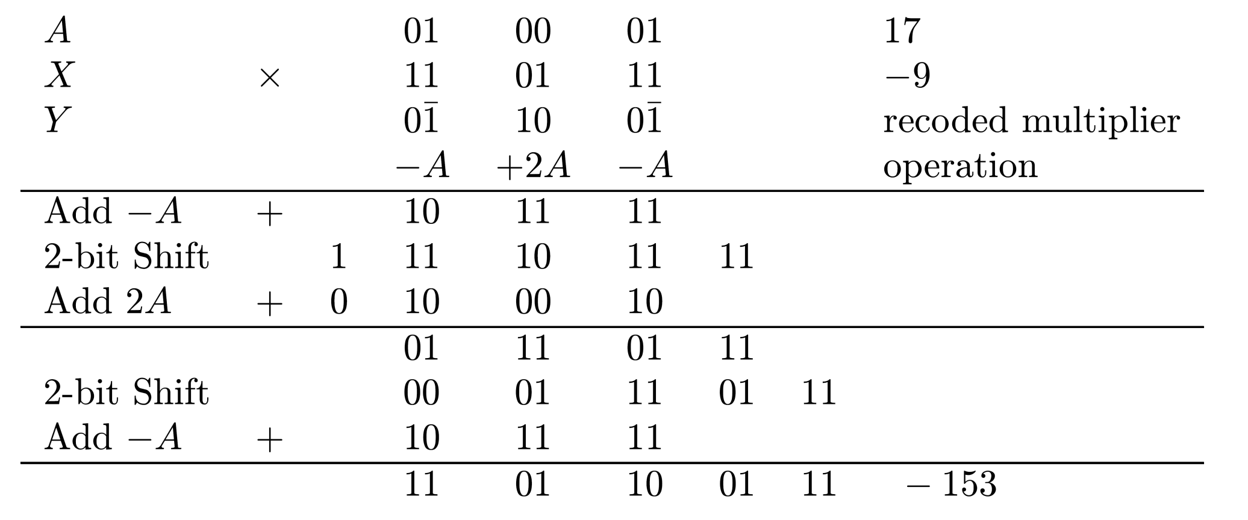
Example
n/2=3 steps ; 2 multiplier bits in each step
All shift operations are 2 bit position shifts
Additional bit for storing correct sign required to properly handle addition of 2A

Slide 15
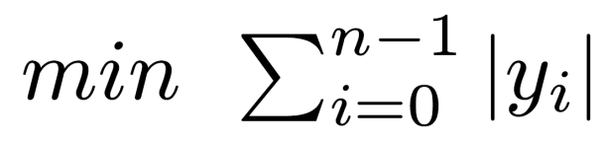
Radix-8 Modified Booth's Algorithm
Recoding extended to 3 bits at a time - overlapping groups of 4 bits each
Only n/3 partial products generated - multiple 3A needed - more complex basic step
Example: recoding 010(1) yields yi yi-1 yi-2=011
Technique for simplifying generation and accumulation of ±3A exists
To find minimal number of add/subtract ops required for a given multiplier - find minimal SD representation of multiplier
Representation with smallest number of nonzero digits -

Slide 16
Obtaining Minimal Representation of X
yn-1yn-2... y0
is a minimal representation of an SD number
if yi⋅yi-1=0 for 1≤ i≤ n-1,
given that most significant bits can satisfy
yn-1⋅yn-2 ≠ 1

Slide 17
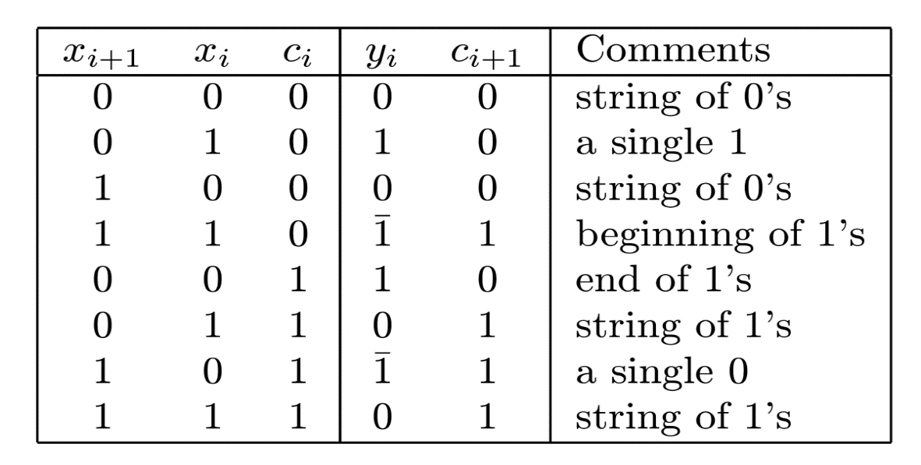
Canonical Recoding
Multiplier bits examined one at a time
from right; xi+1 - reference bit
To correctly handle a single 0/1 in string of 1's/0’s - need information on string to right
“Carry” bit - 0 for 0's and 1 for 1's
As before, recoded multiplier can be used without correction if represented in two's complement
Extend sign bit xn-1 - xn-1xn-1xn-2…x0
Can be expanded to two or more bits at a time
Multiples needed for 2 bits - ±A and ±2A

Slide 18
Disadvantages of Canonical Recoding
Bits of multiplier generated sequentially
In Booth’s algorithm - no “carry” propagation - partial products generated in parallel and a fast multi-operand adder used
To take full advantage of minimum number of operations - number of add/subtracts and length of shifts must be variable - difficult to implement
For uniforms shifts - n/2 partial products - more than the minimum in canonical recoding

Slide 19
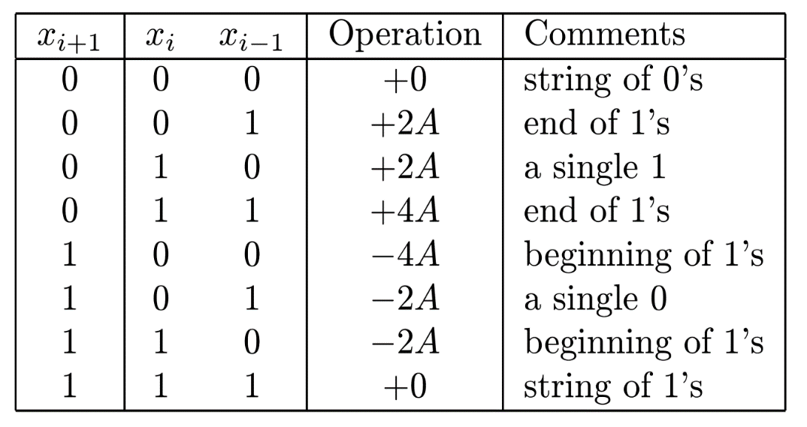
Alternate 2-bit-at-a-time Algorithm
Reducing number of partial products
But still uniform shifts of 2 bits each
xi+1 reference bit for xi xi-1 - i odd
±2A,±4A can be generated using shifts
4A generated when (xi+1)xi (xi-1)=(0)11 - group of 1's - not for (xi+3)(xi+2)xi+1 - 0 in rightmost position
Not recoding - cannot express 4 in 2 bits
Number of partial products - always n/2
Two's complement multipliers - extend sign bit
Unsigned numbers - 1 or 2 0’s added to left of multiplier

Slide 20
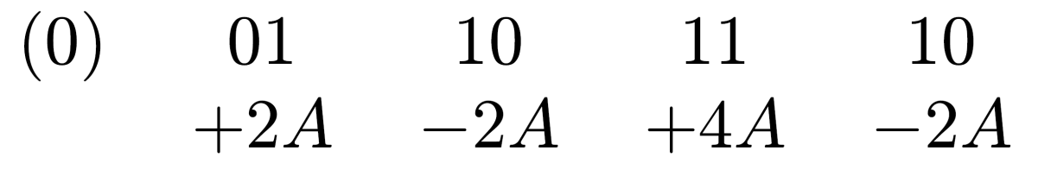
Example
Multiplier 01101110 - partial products:
Translates to the SD number 010110010 - not minimal - includes 2 adjacent nonzero digits
Canonical recoding yields 010010010 - minimal representation

Slide 21
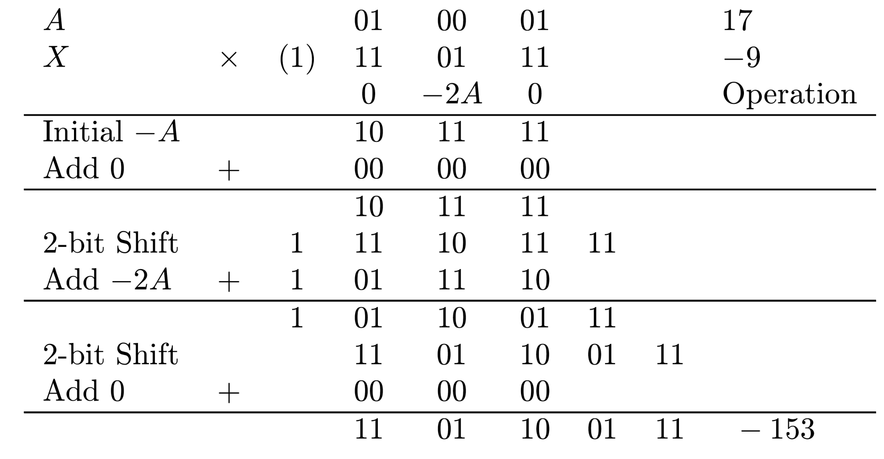
Example
Multiplier's sign bit extended in order to decide that no operation needed for first pair of multiplier bits
As before - additional bit for holding correct sign is needed, because of multiples like -2A

Slide 22
Extending the Alternative Algorithm
The above method can be extended to three bits or more at each step
However, here too, multiples of A like 3A or even 6A are needed and
Prepare in advance and store
Perform two additions in a single step
For example, for (0)101 we need 8-2=6, and for (1)001, -8+2=-6

Slide 23
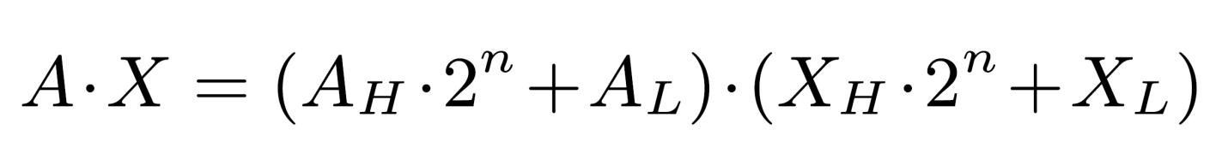
Implementing Large Multipliers Using Smaller Ones
Implementing n x n bit multiplier as a single integrated circuit - several such circuits for implementing larger multipliers can be used
2n x 2n bit multiplier can be constructed out of 4 n x n bit multipliers based on :
AH , AL - most and least significant halves of A ; XH , XL - same for X

Slide 24
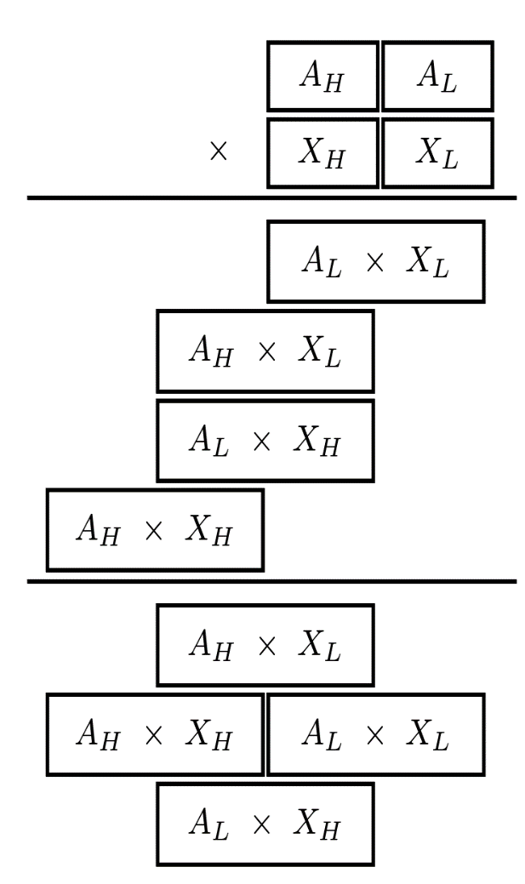
Aligning Partial Products
4 partial products of 2n bits - correctly
aligned before adding
Last arrangement – minimum height of matrix - 1 level of carry-save addition and a CPA
n least significant bits - already bits of final product - no further addition needed
2n center bits - added by 2n-bit CSA with outputs connected to a CPA
n most significant bits connected to same CPA, since center bits may generate carry into most significant bits - 3n-bit CPA needed

Slide 25
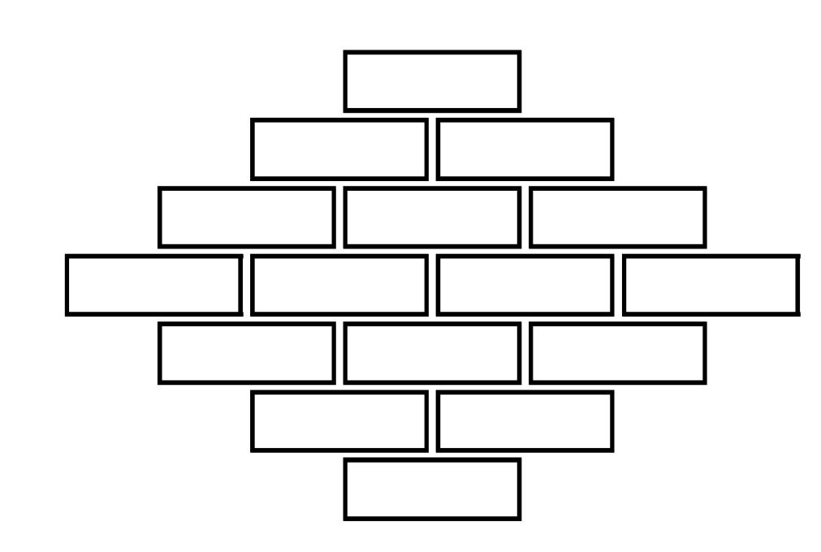
Decomposing a Large Multiplier into Smaller Ones - Extension
Basic multiplier - n x m bits - n ≠ m
Multipliers larger than 2n x 2m can be implemented
Example: 4n x 4n bit multiplier - implemented using n x n bit multipliers
4n x 4n bit multiplier requires 4 2n x 2n bit multipliers
2n x 2n bit multiplier requires 4 n x n bit multipliers
Total of 16 n x n bit multipliers
16 partial products - aligned before being added
Similarly - for any kn x kn bit multiplier
with integer k

Slide 26

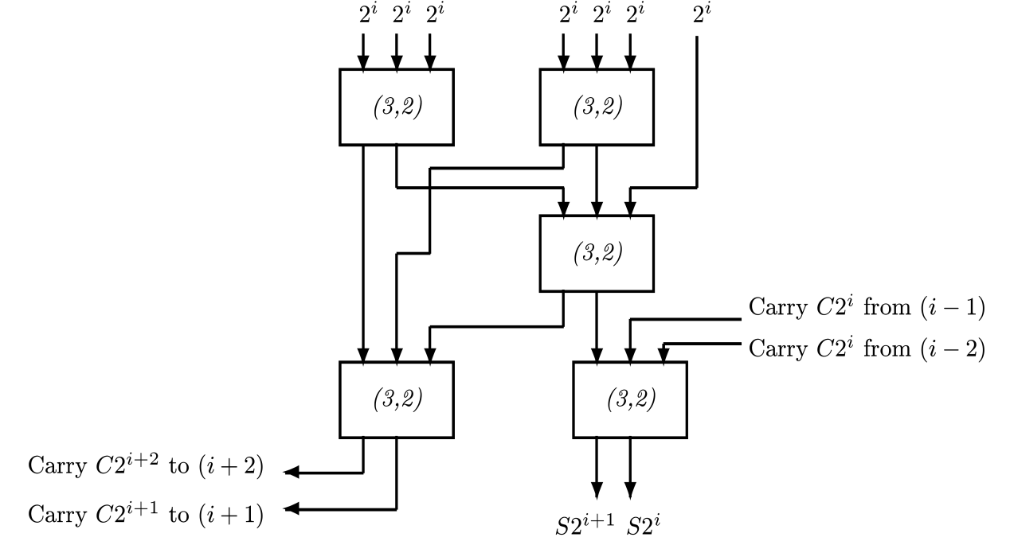
Adding Partial Products
After aligning 16 products - 7 bits in one column need to be added
Method 1: (7,3) counters - generating 3 operands added by
(3,2) counters - generating 2 operands
added by a CPA
Method 2: Combining 2 sets of counters into a set of (7;2) compressors
Selecting more economical multi-operand adder - discussed next

Slide 27
Accumulating the Partial Products
After generating partial products either directly or using smaller multipliers
Accumulate these to obtain final product
A fast multi-operand adder
Should take advantage of particular form of partial products - reduce hardware complexity
They have fewer bits than final product, and must be aligned before added
Expect many columns that include fewer bits than total number of partial products - requiring simpler counters

Slide 28
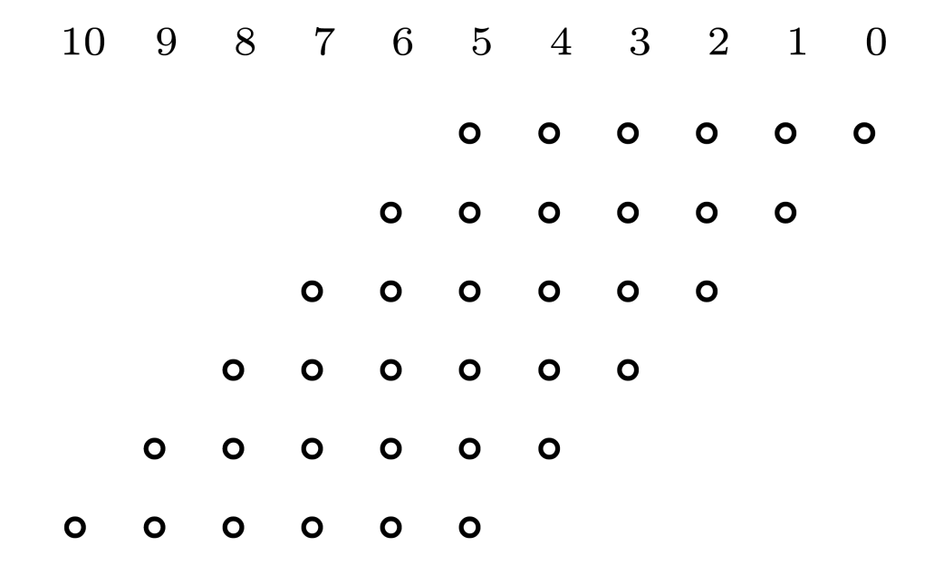
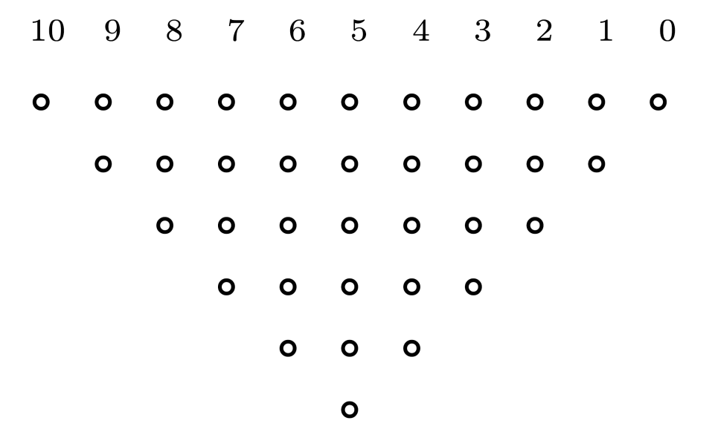
Example - Six Partial Products
Generated when multiplying unsigned 6-bit operands using one-bit-at-a-time algorithm
6 operands can be added using 3-level carry-save tree
Number of (3,2) counters can be substantially reduced by taking advantage of the fact that all
columns but 1 contain fewer than 6 bits
Deciding how many counters needed - redraw matrix of bits to be added:

Slide 29
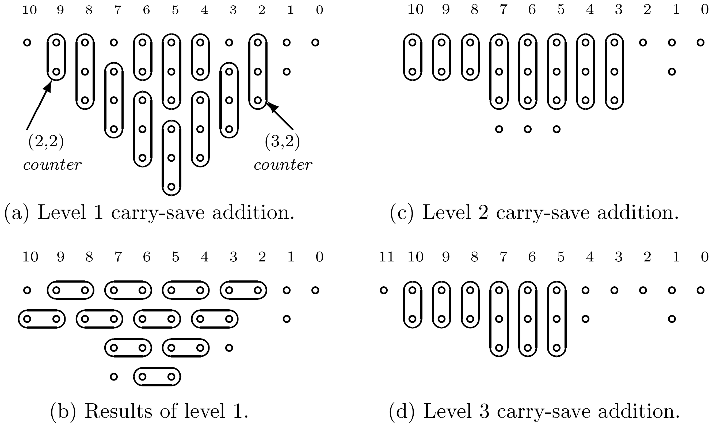
Reduce Complexity - Use (2,2) Counters (HAs)
Number of levels still 3, but fewer counters

Slide 30
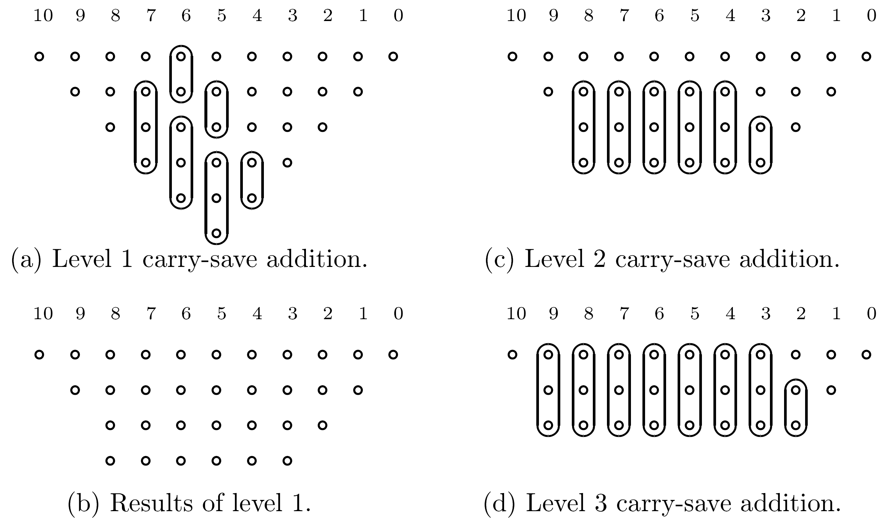
Further reduction in number of counters
Reduce # of bits to closest element of 3,4,6,9,13,19,…
15 (3,2) and 5 (2,2) vs. 16 (3,2) and 9 (2,2) counters

Slide 31
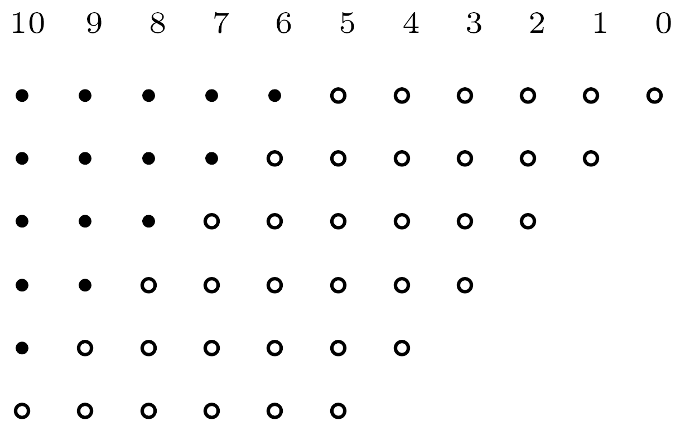
Modified Matrix for Negative Numbers
Sign bits must be properly extended
In row 1: 11 instead of 6 bits, and so on
Increases complexity of multi-operand adder
If two's complement obtained through one's complement - matrix increased even further

Slide 32
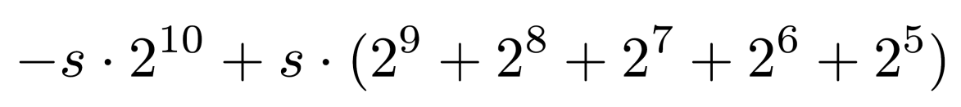
Reduce Complexity Increase
Two's complement number s s s s s s z4 z3 z2 z1 z0 with value
Replaced by 0 0 0 0 0 (-s) z4 z3 z2 z1 z0
since

Slide 33
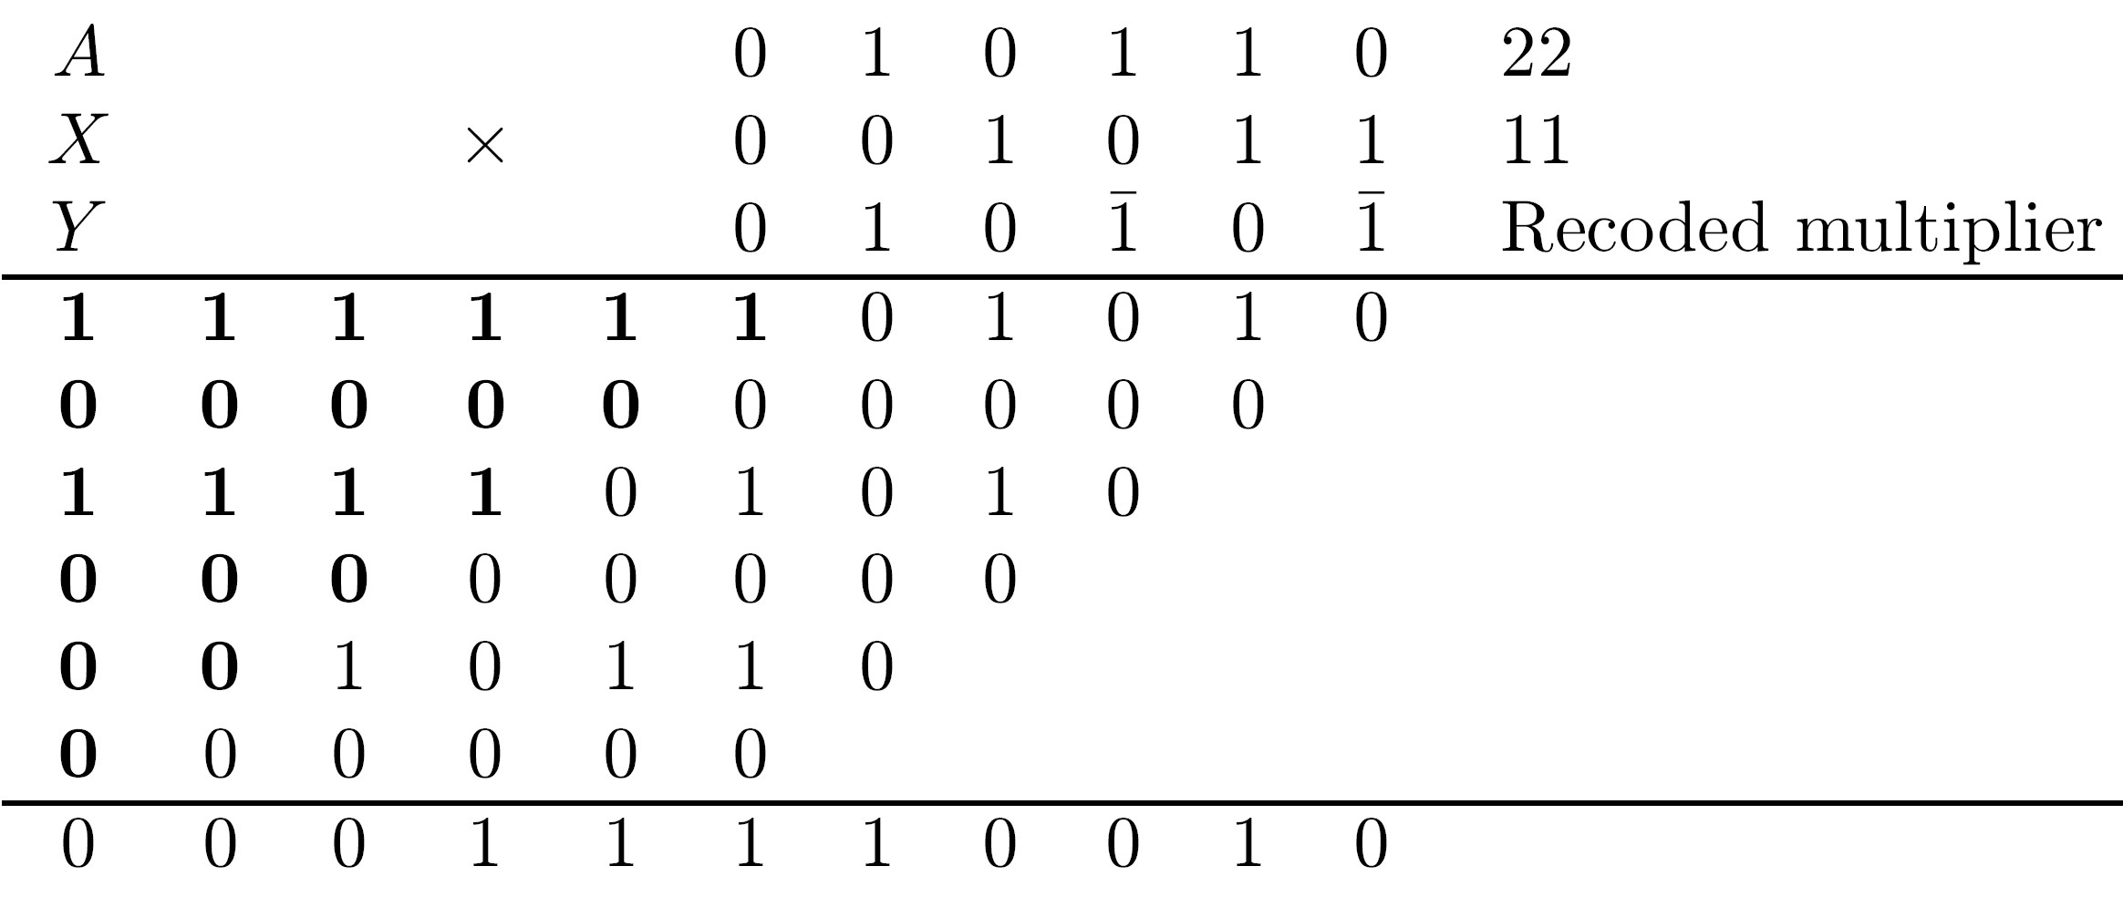
Example
Recoded multiplier using canonical recoding

Slide 34
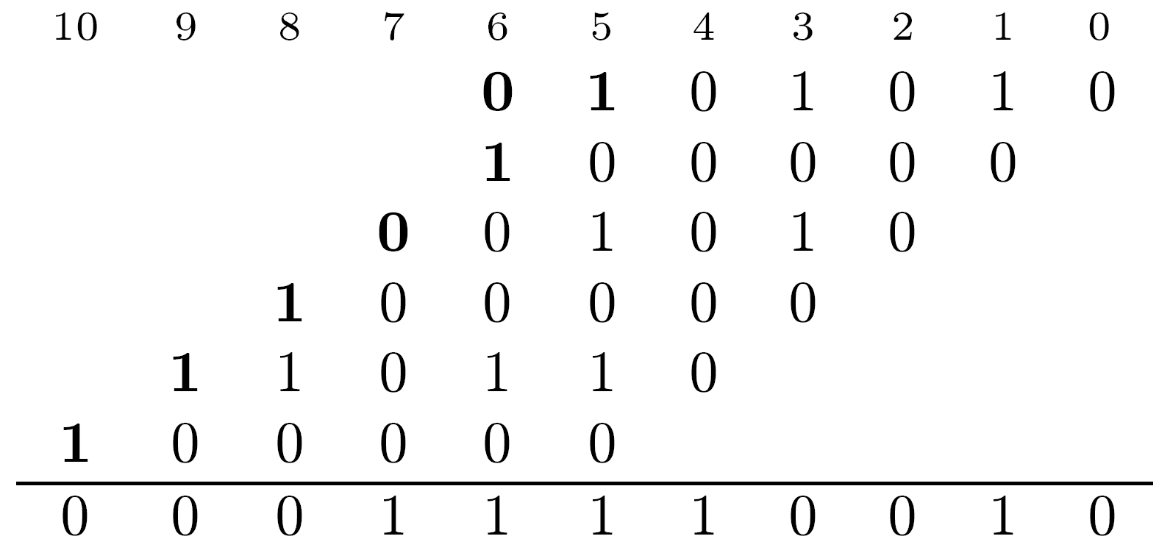
Smaller Matrix for the Example

Slide 35
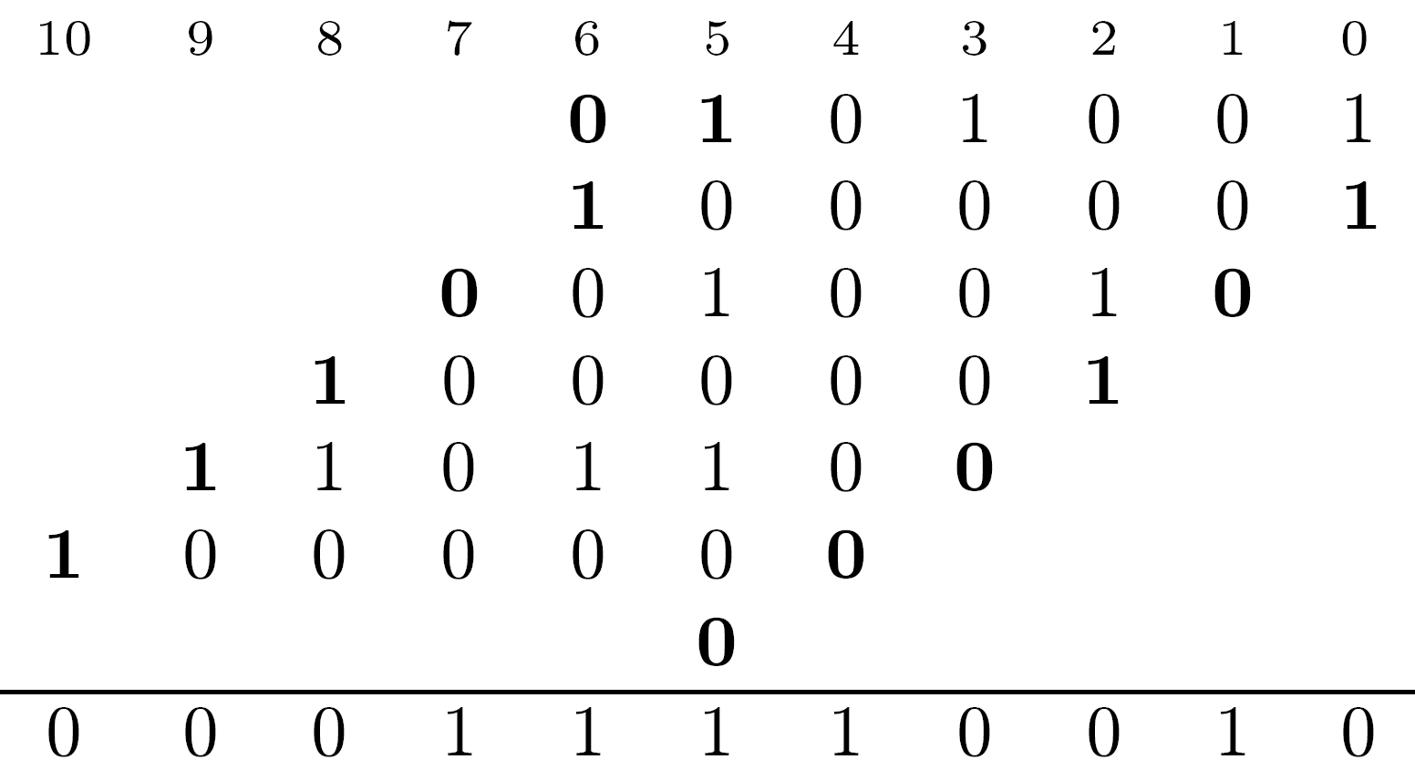
Using One’s Complement and Carry

Slide 36
Array Multipliers
The two basic operations - generation and summation of partial products - can be merged, avoiding overhead and speeding up multiplication
Iterative array multipliers (or array multipliers) consist of identical cells, each forming a new partial product and adding it to previously accumulated partial product
Gain in speed obtained at expense of extra hardware
Can be implemented so as to support a high rate of pipelining

Slide 37
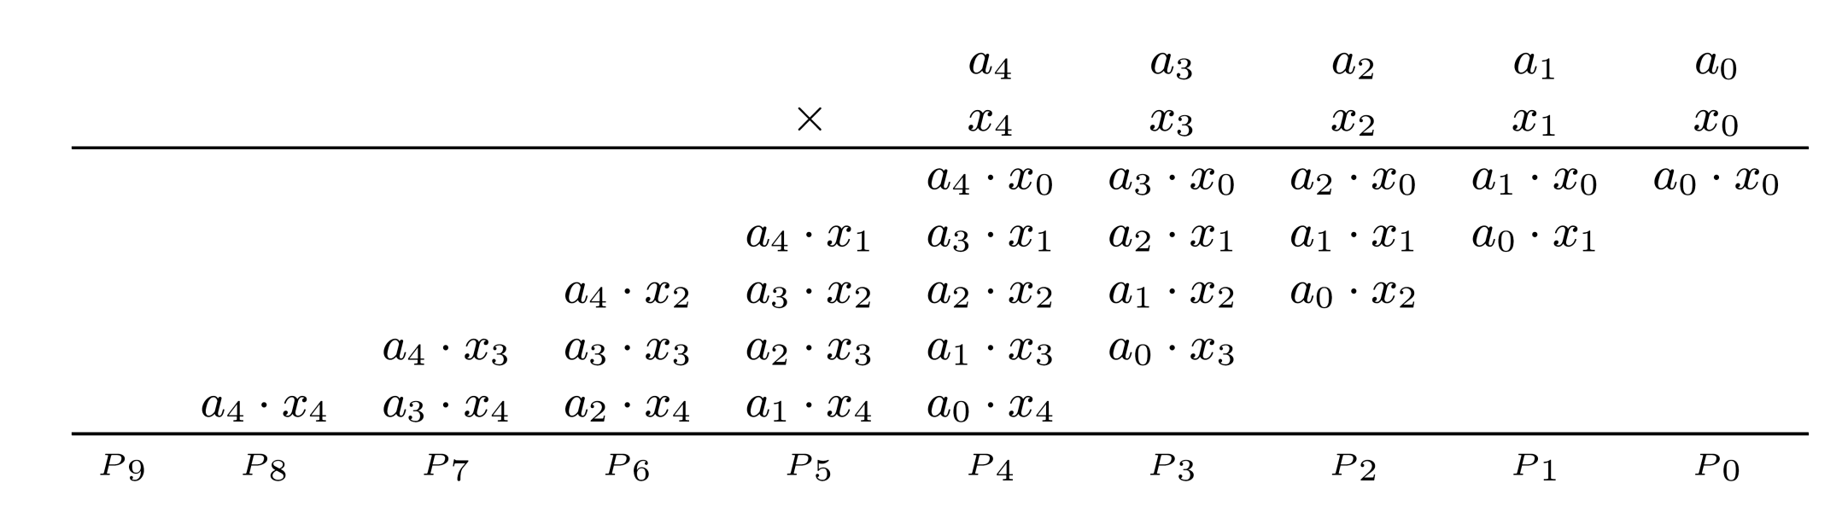
Illustration - 5 x 5 Multiplication
Straightforward implementation -
Add first 2 partial products (a4x0, a3x0,…,a0 x0 and a4x1, a3x1,…,a0x1) in row 1 after proper alignment
The results of row 1 are then added to a4x2, a3x2,…,a0x2 in row 2, and so on

Slide 38
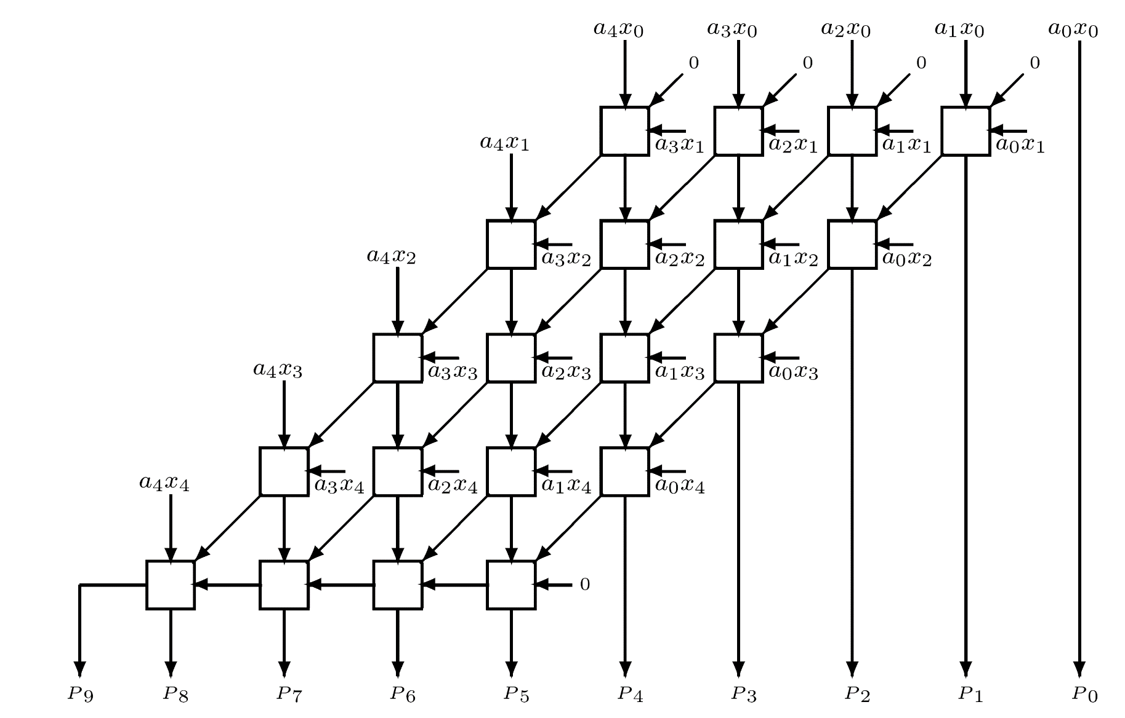
5 x 5 Array Multiplier for Unsigned Numbers
Basic cell - FA accepting one bit of new partial
product aixj+ one bit of previously accumulated partial product + carry-in bit
No horizontal carry propagation in first 4 rows - carry-save type addition - accumulated partial product consists of intermediate sum and carry bits
Last row is a ripple-carry adder - can be replaced by a fast 2-operand adder (e.g., carry-look-ahead adder)

Slide 39
4*4 bit Array Multiplier

Slide 40
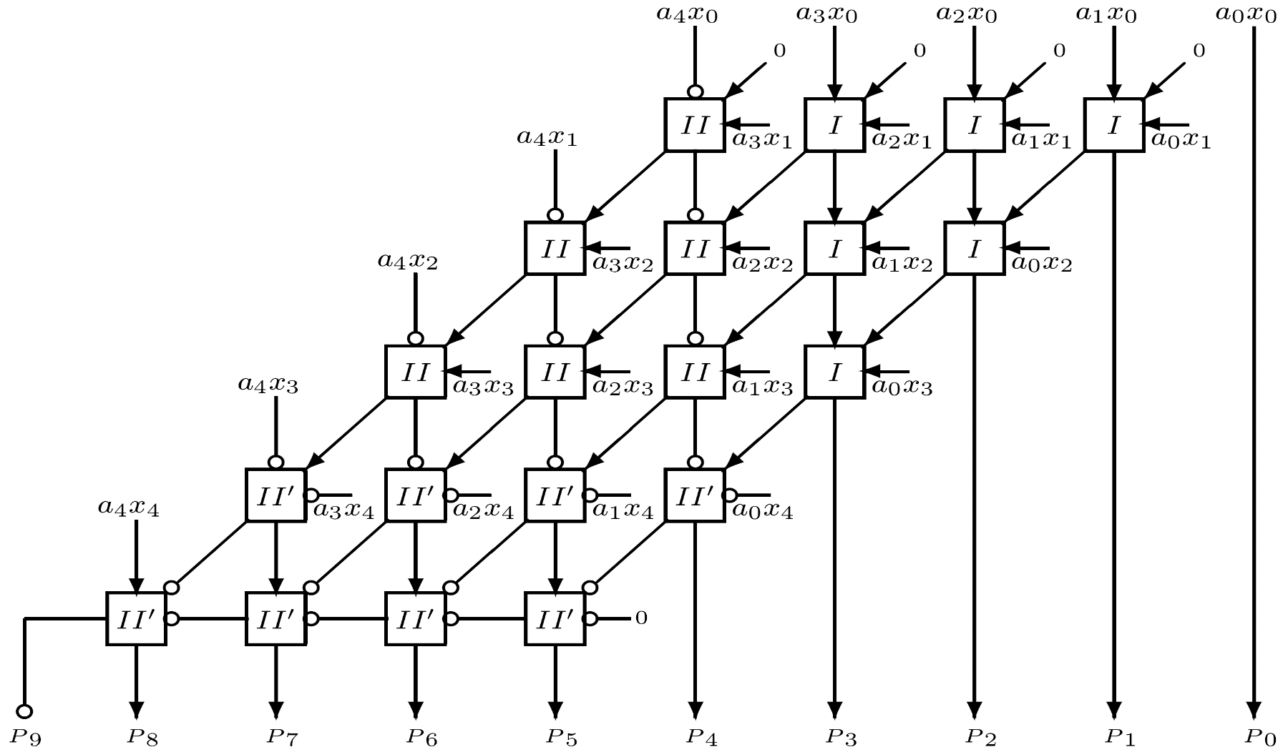
Array Multiplier for Two’s Complement Numbers
Product bits like a4x0 and a0x4 have negative weight
Should be subtracted instead of added

Slide 41
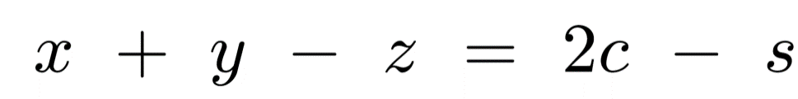
Type I and II Cells
Type I cells: 3 positive inputs - ordinary FAs
Type II cells: 1 negative and 2 positive inputs
Sum of 3 inputs of type II cell can vary from -1 to 2
c output has weight +2
s output has weight -1
Arithmetic operation of type II cell -
s and c outputs given by
S= x + y –z (mod 2) c= [(x+y-z) +s] / 2
II

Slide 42
Type I’ and II’ Cells
Type II' cells: 2 negative inputs and 1 positive
Sum of inputs varies from -2 to 1
c output has weight -2
s output has weight +1
Type I' cell: all negative inputs -has negatively weighted c and s outputs
Counts number of -1's at its inputs - represents this number through c and s outputs
Same logic operation as type I cell - same gate implementation
Similarly - types II and II' have the same gate implementation
II’

